Slide 1
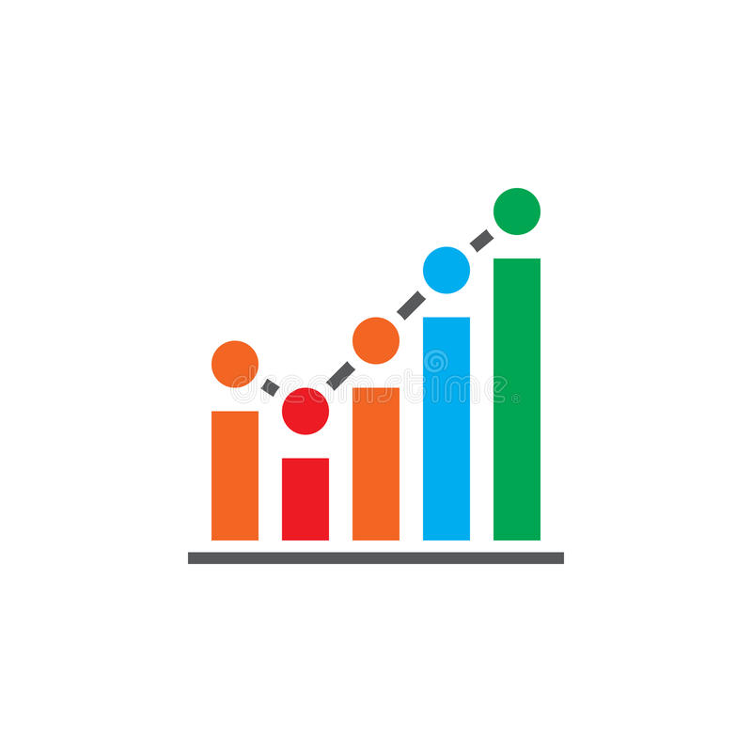
“DATA VISUALIZATION”
Presented By
SHARIQ ALI (21F-CSE-11)
ZAINAB LAKHO (21F-CSE-08)

Slide 2
Software that present data through visual representation such as graphs, charts or heat maps are known as data visualization applications.
WHAT IS DATA VISUALIZATION SOFTWARE?

Slide 3
OBJECTIVES:
To understand the concepts of data visualization and its importance in data analysis.
To learn how to use different tools and libraries in Java for data visualization.
To implement data visualization techniques in Java for various data sets.
To evaluate the effectiveness of the different data visualization techniques.

Slide 4

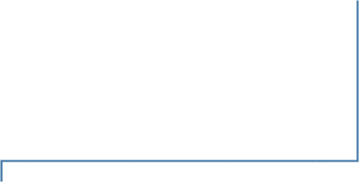


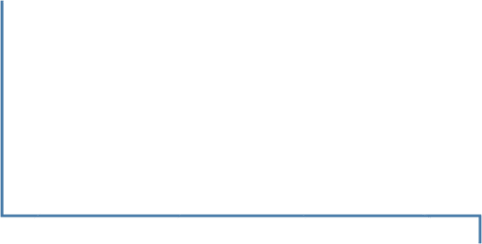


FLOWCHART
Welcome
Screen
DataBase
table
3
D Bar
Bar Chart
Line Chart
Pie Chart
Chart

Slide 5
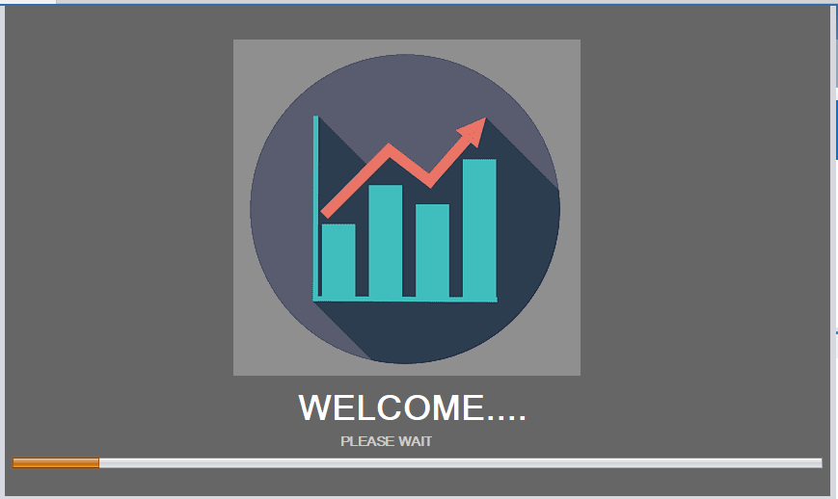
A welcoming screen will appear for a maximum of 5-10 seconds.

Slide 6
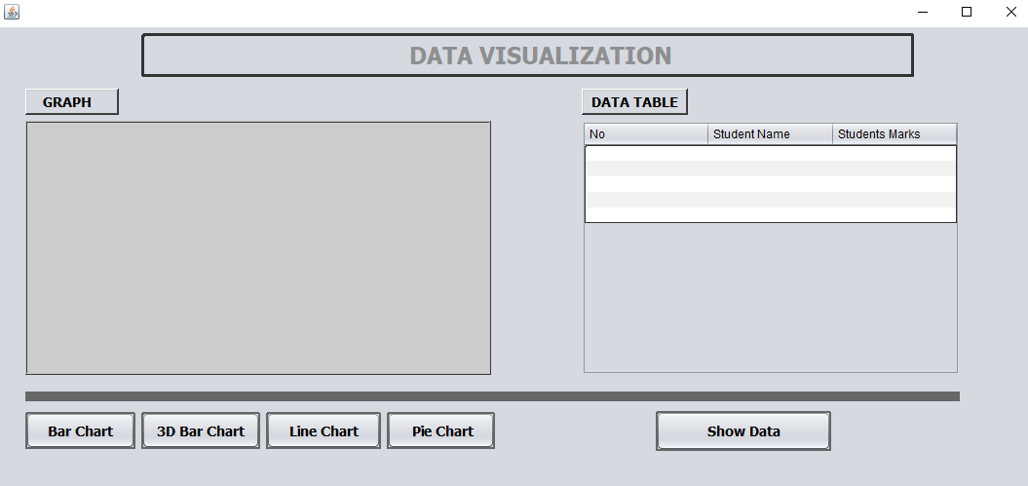
Here, we have added four different type of graphic representation for data.

Slide 7
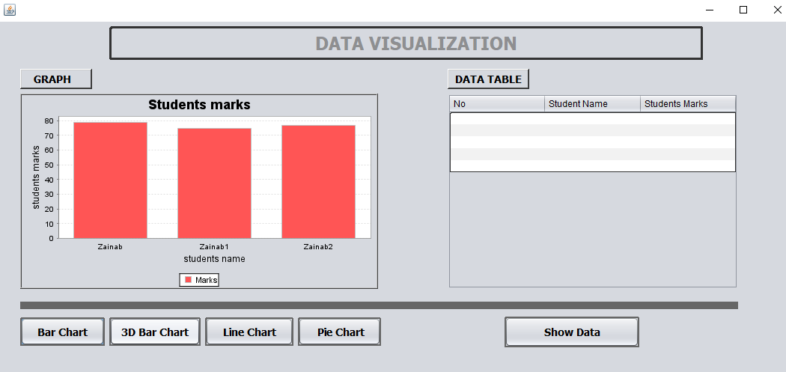
Implementation of Bar chart with dummy data

Slide 8
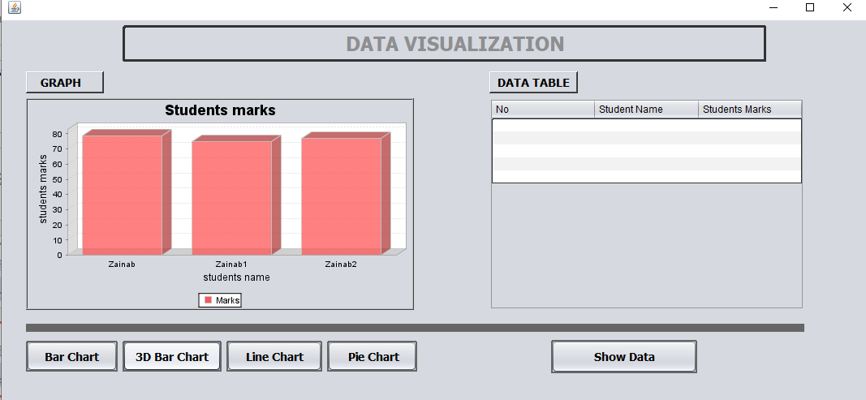
Implementation of 3D-bar chart with dummy data

Slide 9
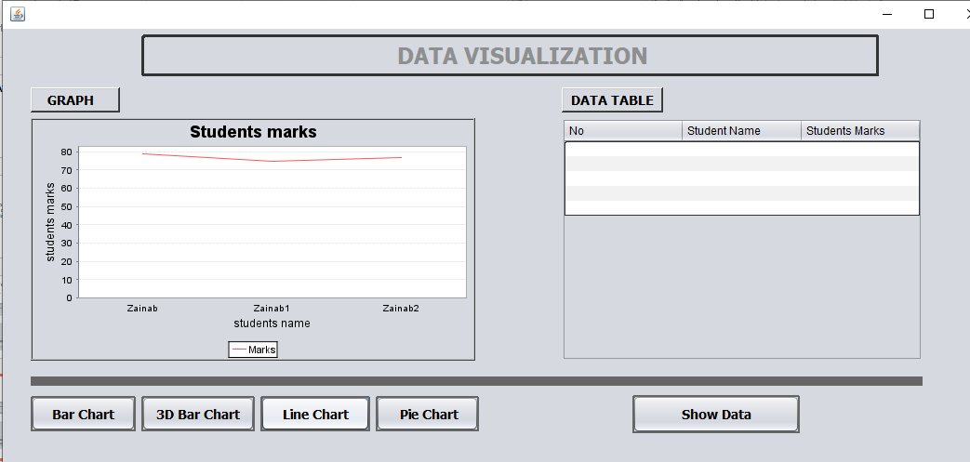
Implementation of line chart with dummy data

Slide 10
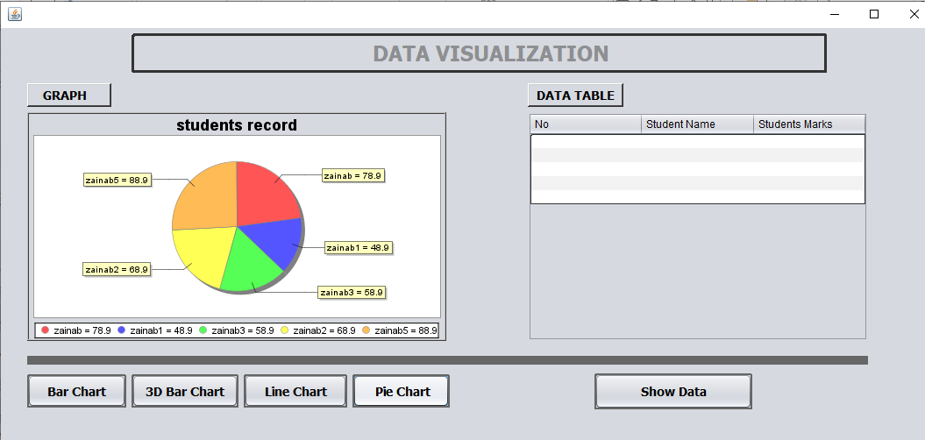
Implementation of pie chart with dummy data

Slide 11
Which object-oriented programming (OOP) concepts have we used in our project?
We have implement input/output, jfreechart, swing and sql libraries.
Along with Concept of:
Inheritance
Exception handling
Polymorphism
Database
Threading
Encapsulation

Slide 12
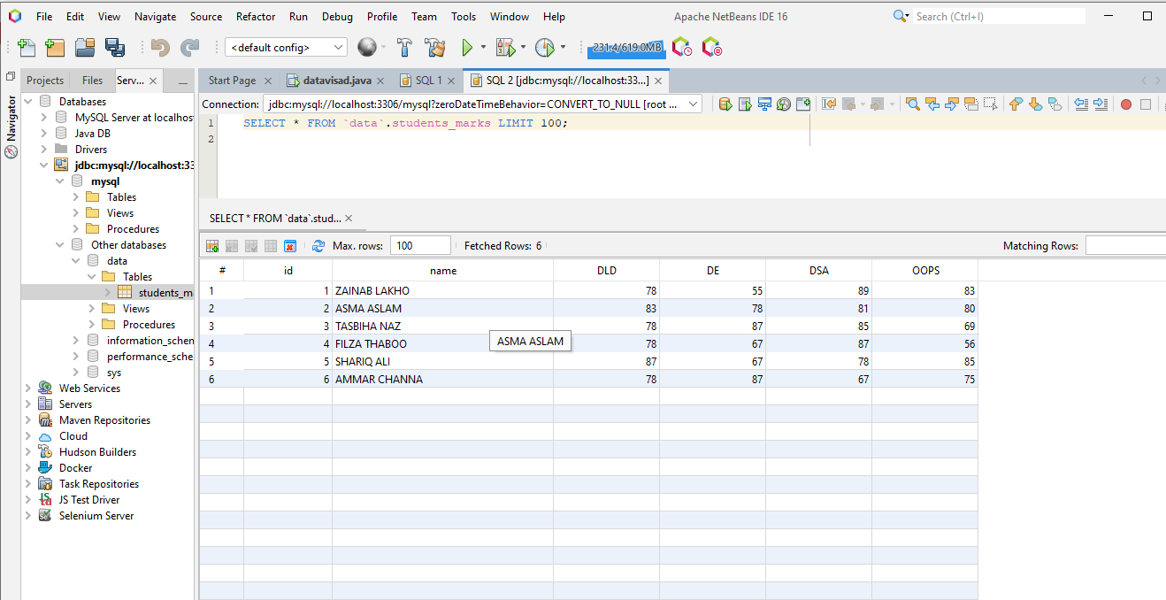
We have created a database and inserted the required record in it.

Slide 13
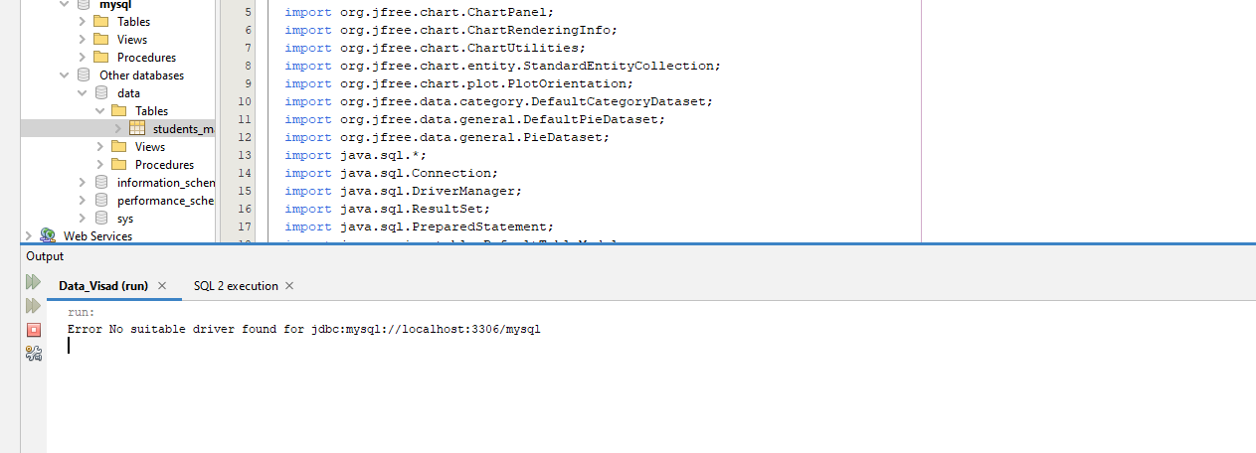
The only error we’re facing is an error of database driver

Slide 14
THANK YOU

